Slide 1
How Continuous Delivery and Lean Management Make Your DevOps Amazeballs
Nicole Forsgren, PhD
Director of Organizational Performance & Analytics, Chef

Slide 2

Notes:
Last year, I spoke about the link we found between IT investments and the Bottom Line, but only if these investments – automation and tooling – are accompanied by practice and process and culture, that we call DevOps.

Slide 3

One year later…
Notes:
Well, it’s a year later, and there’s new data. So what do we know now?

Slide 4
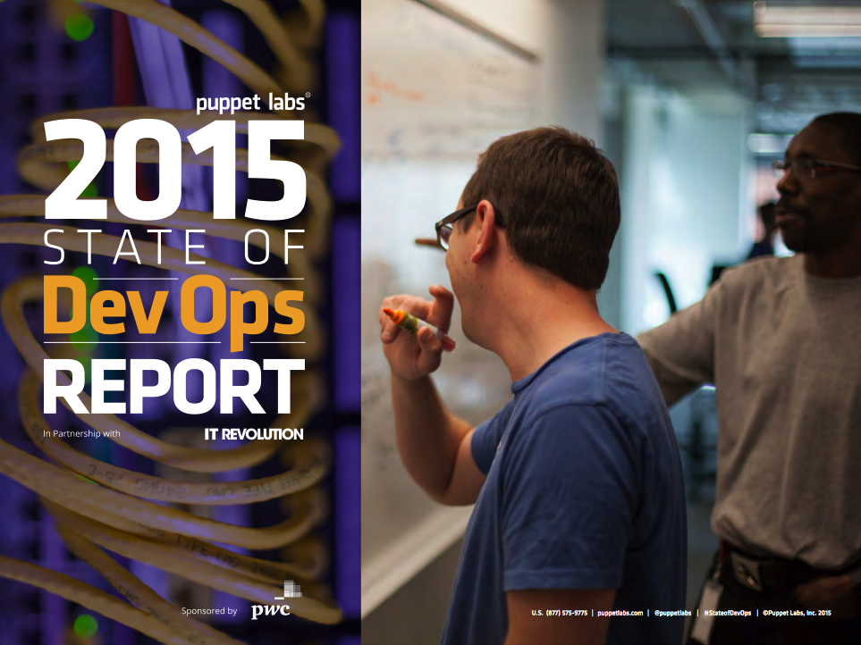
The Deets
4,976 respondents in 2015
9,288 respondents in 2014
Three groups of IT Performers:
High
Medium
Low
Statistics BINGO:
Correlation, CMV, PLS, SEM, EFA, varimax, Eigenvalue, factor, lconstruct
Notes:
First, some quick info about where this comes from

Slide 5
DevOps is good for business
IT Performance
Org Performance
Notes:
Let’s cut to the good stuff

Slide 6
DevOps is good for business
IT Performance
Org Performance
Notes:
Again, we find that when we talk about DevOps, IT Performance impacts Organizational Performance
It was great to validate this again

Slide 7
DevOps is good for business
High Performing IT Organizations:
2x
50%
More likely to exceed
Profitability,
Market share, and
Productivity goals
(2014 and 2015)
Higher market cap
growth over 3 years*
(2014*)
Org Performance
The 2014 DevOps Survey of Practice and its resulting database are the property of Puppet Labs, Inc. and Gene Kim and Associates, LLC. All rights reserved.

Slide 8
DevOps is good for IT Performance
IT Performance
Org Performance
Notes:
We also find, AGAIN, that DevOps is good for IT Performance

Slide 9
But what IS IT Performance?
It is measured by:
Agility
Deploy frequency
Lead time
Reliability
MTTR
Change fail rate*
IT Performance
Org Performance
Notes:
But what *IS* IT Performance? Let’s remind ourselves quickly.
And it’s worth noting that these numbers – agility and reliability – move TOGETHER. We don’t’ see tradeoffs.
Let’s look.

Slide 10
DevOps is good for IT performance
High Performing IT Organizations:
More agile
30x
200x
IT Performance
Org Performance
More frequent
Deployments
(2015 and 2014)
Faster lead times
than peers
(2015 and 2014)
The 2015 DevOps Survey of Practice and its resulting database are the property of Puppet Labs, Inc. and Gene Kim and Associates, LLC. All rights reserved.

Slide 11
DevOps is good for IT performance
High Performing IT Organizations:
More reliable
168x (2015)
48x (2014)
60x
3x
IT Performance
Org Performance
Faster
Mean time to recovery
(MTTR)
Change
Success
Rate*
The 2015 DevOps Survey of Practice and its resulting database are the property of Puppet Labs, Inc. and Gene Kim and Associates, LLC. All rights reserved.

Slide 12
Key Factors that Correlate with Each Component:
MTTR
Also Super
Important:
Version control for all production artifacts
Monitoring
Lead time for changes
Culture***
Job satisfaction
Climate for learning
Version control for all production artifacts
Automated testing
Deployment Frequency
Version control for all production artifacts
Continuous Delivery
The 2014 DevOps Survey of Practice and its resulting database are the property of Puppet Labs, Inc. and Gene Kim and Associates, LLC. All rights reserved.
Notes:
And notice Culture – this was predictive of IT Performance and Org Performance in the 2014 report

Slide 13
But what drives IT Performance?
???
IT Performance
Org Performance
Notes:
This year, we wanted to see what makes our IT Performance, well, amazeballs.

Slide 14
But what drives IT Performance?
1.
???
IT Performance
Org Performance
Notes:
Step 1

Slide 15
But what drives IT Performance?
2.
1.
???
IT Performance
Org Performance
Notes:
Step 2
…
And do we know what comes next?

Slide 16

But what drives IT Performance?
2.
1.
$$$
???
IT Performance
Org Performance

Slide 17
But what drives IT Performance?
Continuous Delivery
IT Performance
Org Performance
The 2015 DevOps Survey of Practice and its resulting database are the property of Puppet Labs, Inc. and Gene Kim and Associates, LLC. All rights reserved.
Notes:
We started by looking into Continuous Delivery.

Slide 18
Continuous Delivery practices
Test deployment
& automation
Continuous Delivery
IT Performance
Org Performance
Continuous
integration
All production artifacts in version control
The 2015 DevOps Survey of Practice and its resulting database are the property of Puppet Labs, Inc. and Gene Kim and Associates, LLC. All rights reserved.

Slide 19
Continuous Delivery makes our work better
Lower Change Fail Rates
Test deployment
& automation
Continuous Delivery
IT Performance
Org Performance
Continuous
integration
All production artifacts in version control
The 2015 DevOps Survey of Practice and its resulting database are the property of Puppet Labs, Inc. and Gene Kim and Associates, LLC. All rights reserved.

Slide 20

“We never had testability before. We have it now. We have this experience and know this stuff is working, and working with controls.”
– Product Owner for Yahoo Chef implementation
Automated configuration and deployment of 250,000 nodes
Can deploy up to 140k node configurations in 8 hours.
Can patch entire infrastructure within 6 hours of a patch being made available

Slide 21
Continuous Delivery makes our work better… and makes it feel better!
Lower Change Fail Rates
Test deployment
& automation
Continuous Delivery
IT Performance
Org Performance
Continuous
integration
All production artifacts in version control
Lower Deployment Pain
The 2015 DevOps Survey of Practice and its resulting database are the property of Puppet Labs, Inc. and Gene Kim and Associates, LLC. All rights reserved.

Slide 22
Continuous Delivery makes our work better… and makes it feel better!
Lower Change Fail Rates
Test deployment
& automation
Continuous Delivery
IT Performance
Org Performance
Continuous
integration
All production artifacts in version control
Lower Deployment Pain
The 2015 DevOps Survey of Practice and its resulting database are the property of Puppet Labs, Inc. and Gene Kim and Associates, LLC. All rights reserved.

Slide 23
But what else drives IT Performance?
Lean Management
IT Performance
Org Performance
The 2015 DevOps Survey of Practice and its resulting database are the property of Puppet Labs, Inc. and Gene Kim and Associates, LLC. All rights reserved.

Slide 24
Lean Management practices
WIP limits: drive improvement
Lean Management
IT Performance
Org Performance
Visualizations to monitor work
Monitoring to make business decisions
The 2015 DevOps Survey of Practice and its resulting database are the property of Puppet Labs, Inc. and Gene Kim and Associates, LLC. All rights reserved.

Slide 25
Lean Management makes our work better
WIP limits: drive improvement
Lean Management
IT Performance
Org Performance
Visualizations to monitor work
Monitoring to make business decisions
The 2015 DevOps Survey of Practice and its resulting database are the property of Puppet Labs, Inc. and Gene Kim and Associates, LLC. All rights reserved.

Slide 26

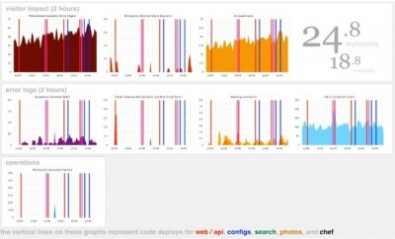
“If it moves, graph it.”
- Michael Rembetsy, Vice President Operations, Etsy

Slide 27
Lean Management makes our work better… and makes it feel better!
Improved Org Culture (Westrum)
WIP limits: drive improvement
Lean Management
IT Performance
Org Performance
Visualizations to monitor work
Monitoring to make business decisions
Decreased Burnout
The 2015 DevOps Survey of Practice and its resulting database are the property of Puppet Labs, Inc. and Gene Kim and Associates, LLC. All rights reserved.

Slide 28

“I was trying to figure out why my team was working themselves to death but not getting anything done… By implementing WIP limits, we were able to focus on our work. Finishing work feels better than sprinting and feeling like a hero in the moment, because that’s only a moment.”
- Julia Wester, Development Manager for Turner Sports, Turner Broadcasting

Slide 29
Lean Management makes our work better… and makes it feel better!
Improved Org Culture (Westrum)
WIP limits: drive improvement
Lean Management
IT Performance
Org Performance
Visualizations to monitor work
Monitoring to make business decisions
Decreased Burnout
The 2015 DevOps Survey of Practice and its resulting database are the property of Puppet Labs, Inc. and Gene Kim and Associates, LLC. All rights reserved.
Notes:
Also notice Culture… this should be familiar from the 2014 study

Slide 30
DevOps drives IT & Organizational Performance
☐ Tooling and automation
☐ Practice and process
☐ Culture

Slide 31
DevOps drives IT & Organizational Performance
Tooling and automation
Continuous Delivery
Practice and process
Lean Management
Culture
Westrum – high trust & information flow
Notes:
This is such an empowering story, and we’re hearing that it’s resonating, and helping people get buy-in for DevOps transformations at their organizations.
Keep up the good work!
If this is something that is of interest for you…

Slide 32
DevOps Benchmarking
From the team that brought you the Puppet Labs State of DevOps Report: Gene Kim, Jez Humble & Nicole Forsgren, PhD
Benchmark your performance across four axes: culture, automation, process, measurement
Compare your IT Performance against the industry standard
Get a personalized report with results you can share

Slide 33
Want to learn more?
To receive the following:
An exclusive invite to our DevOps benchmarking tool
A chance for a personalized analysis of your results with Gene, Jez, and Nicole
A copy of this presentation
A copy of the metrics guidance whitepaper from the DevOps Forum
Just send an email
To: nicolefv@sendyourslides.com
Subject: devops

Slide 34
Thank you
nicole@chef.io
@nicolefv
nicoleforsgren.com

